Slide 1

Introductory Circuit Analysis
2020.3
Chapter 1 Basic Concept

Slide 2
Chapter 1 Basic Concept
1.1 Charge and Current
1.2 Voltage
1.3 Ass
Circuit Elements
1.4 Summary and Review

Slide 3
1.1 Charge and Current
1.Charge
We know from elementary physics that all matter is made of fundamental building blocks known as atoms and that each atom consists of electrons, protons, and neutrons.
Charge is an electrical property of the atomic particles of which matter consists, measured in coulombs (C).
The charge e on one electron is negative and equal in magnitude to 1.602 × 10⁻¹⁹ C which is called as electronic charge.
A unique feature of electric charge or electricity is the fact that it is mobile, that is, it can be transferred from one place to another, where it can be converted to another form of energy.

Slide 4
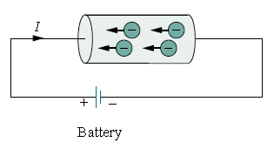
conducting wire
When a conducting wire (consisting of several atoms) is connected to a battery (a source of electromotive force), the charges are compelled to move;
positive charges move in one direction while negative charges move in the opposite direction.
This motion of charges creates electric current.

Slide 5
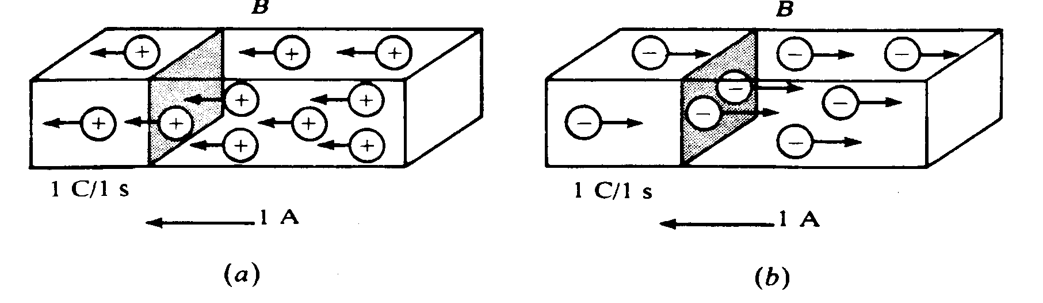
2. Current
The motion of charges forms the electric current in a wire.
The current has two factors: a numerical value ,a direction.
Positive ions
Negative ions
It is conventional to take the current flow as the movement of positive charges, that is, opposite to the flow of negative charges

Slide 6
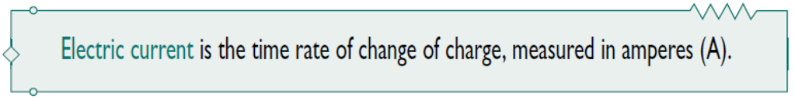
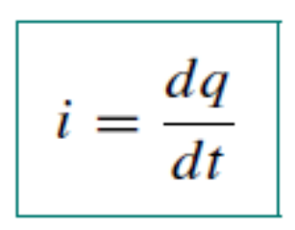
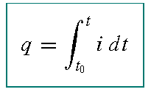
It is a measure of the rate at which charge is moving past a given reference point in a specified direction.
Electric current
The unit of current is the ampere (A), and it can be derived as 1 A = 1C/s.
The charge transferred between time t₀ and t is obtained by integrating

Slide 7
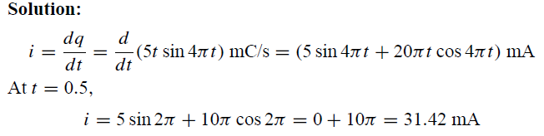
EXAMPLE 1.1
The total charge entering a terminal is given by
q = 5t sin 4πt mC. Calculate the current at t = 0.5 s.

Slide 8
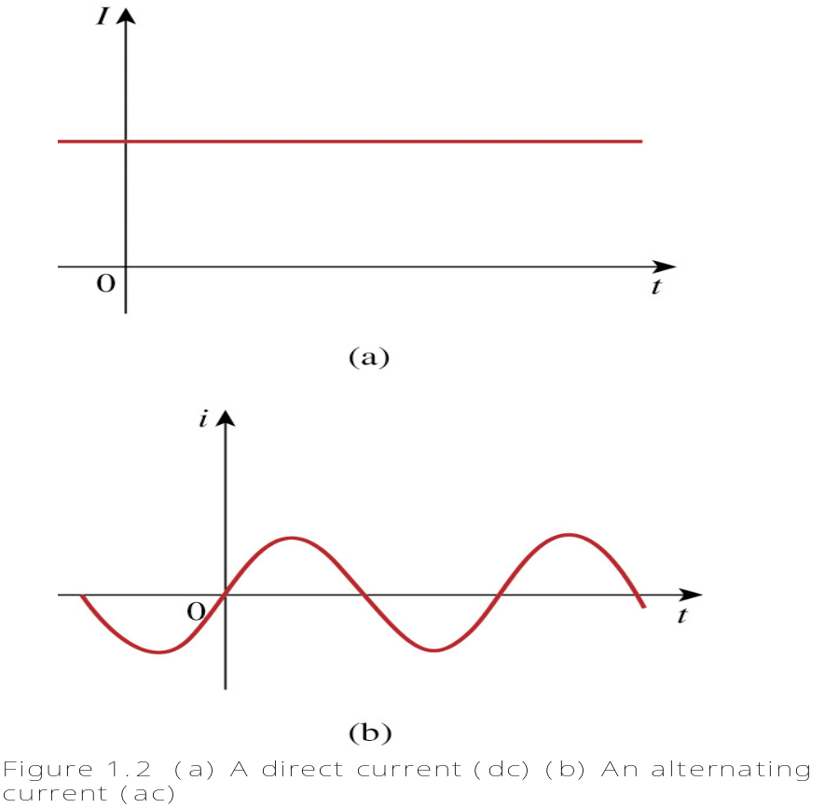
A direct current (dc) is a current that remains constant with time.
An alternating current (ac) is a current that varies sinusoidally with time.
Constant current--I
time-varying current--i

Slide 9
Current direction
The direction of current flow is conventionally taken as the direction of positive charge movement
⊕
Real direction
A
B
Real direction
⊕
A
B
Question:
In complex circuit or direction of current flow change with time，how to estimate real direction of current?

Slide 10
Reference direction
The direction of positive charge movement
i reference direction
A
B
Relation of reference direction and real direction：
i Reference direction
i Reference direction
A
B
A
B
Real direction
Real direction
i > 0
i < 0

Slide 11
Two express of reference direction：
• Arrowhead：Arrowhead point to current referent direction
i
A
B
Subscript：such as i_{AB} ; referent direction: from A to B。
i_{AB}
A
B

Slide 12
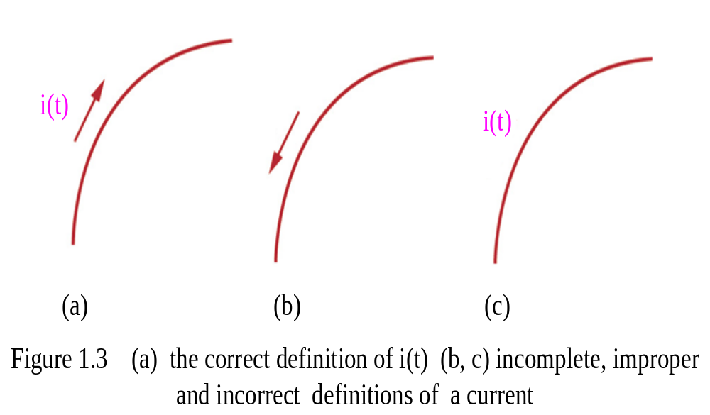
We should pay close attention to that a numerical value and a direction are fundamental parts of the definition of the current!
For example, Fig. 1.3a is the proper definition, whereas Fig. 1.3b and c are meaningless representation of i(t) symbology.

Slide 13
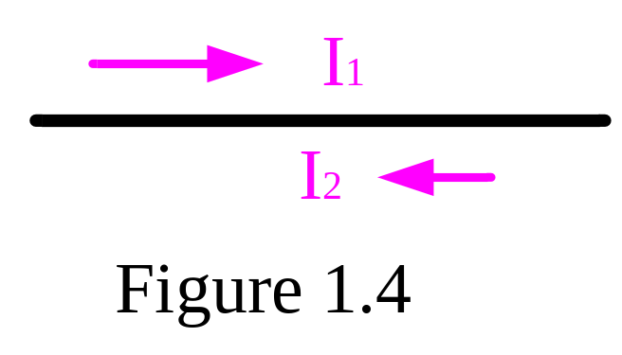
-------------------------------------------------
Practice 1.1:
In the wire of Fig. 1.4 electrons moving from left to right to create a current of 1 mA. Determine I₁ and I₂.
----------------------------------------------------------------
Ans: I1 = -1 mA; I2 = +1 mA.
The direction of current flow is conventionally taken as the direction of positive charge movement.

Slide 14
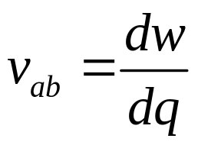
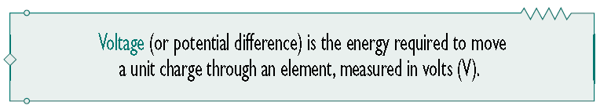
1.2 Voltage
The voltage (or potential difference) across a terminal pair is the work (energy ) required to move a unit charge through an element, measured in volts (V).
Mathematically,
(volt)

Slide 15
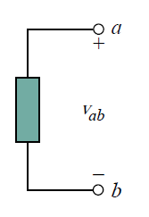
Reference Direction
  v_{ab} > 0 means the potential of a is higher than potential of b.
  v_{ab} < 0 means the potential of a is lower than potential of b.
We should note that a voltage can exist between a pair of electrical terminals whether a current is flowing or not.
The plus (+) and minus (−) signs are used to define reference direction or voltage polarity.
The v_{ab} can be interpreted in two ways:
(1) point a is at a potential of v_{ab} volts higher than point b;
(2) the potential at point a with respect to point b is v_{ab}.
Note: The definition of any voltage must include plus-minus sign pair!

Slide 16
Question:
For complex circuit, how to make certain voltage direction?
Voltage drop reference direction
Reference Direction
U
Reference Direction
U
+
–
+
–
+
Real direction
Real direction
+
U
< 0
U
> 0

Slide 17
Express for Voltage drop reference direction：
(1) Arrow :
U
(2) Polarity of plus and minus:
+
U
(3) Subscript：
U_{AB}
A
B

Slide 18
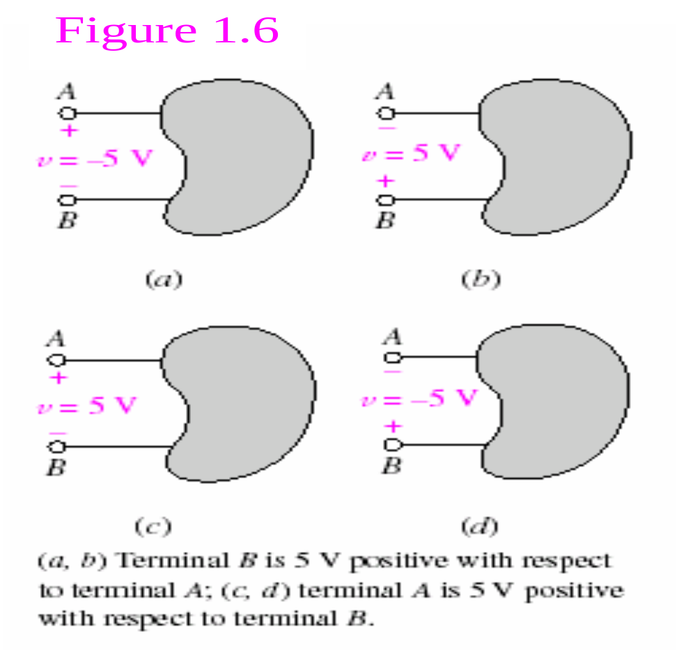
In Fig. 1.6a, for example, the placement of +sign in terminal A indicates that terminal A is v volts positive with respect to terminal B.

Slide 19
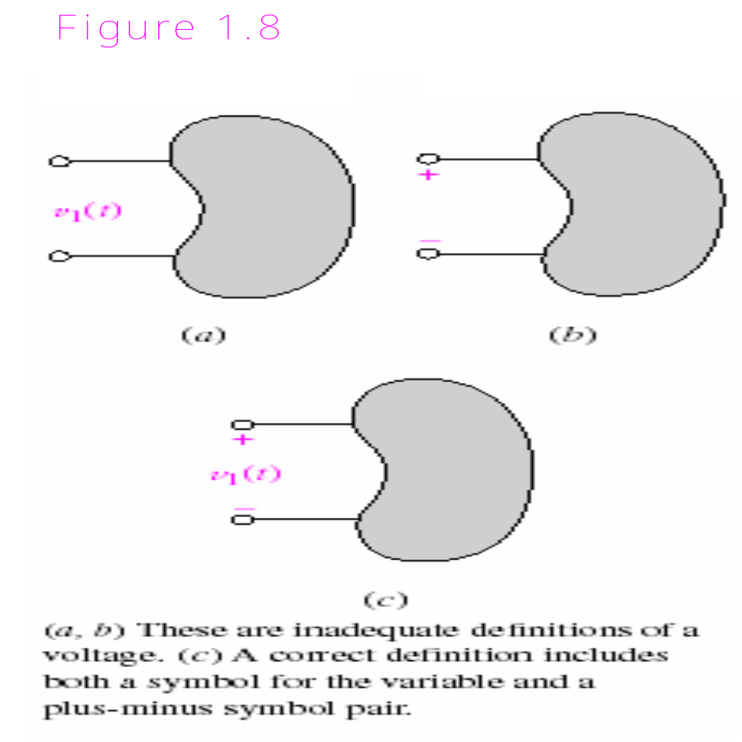

Slide 20
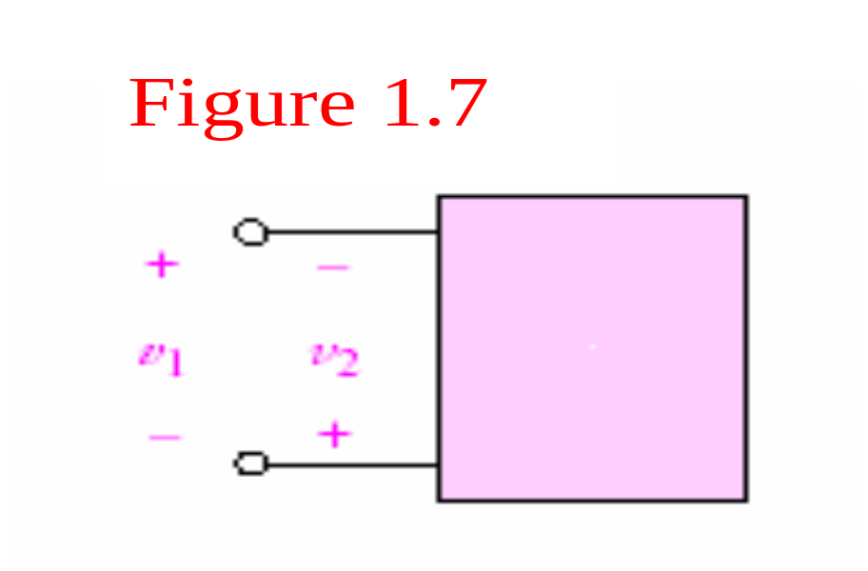
Practice 1.2
For the element in Fig. 1.7, v₁ =17 V. Determine v₂.
---------------------------------------------------
Ans: v₂ = - 17 V
----------------------------------------------------------------------

Slide 21
1.3 Passive sign convention
Passive sign convention: current(reference direction) enters through the positive polarity of the voltage (reference direction).
i
i
+
-
-
+
U
U
Passive sign convention
Associate Reference Direction
Active sign convention
Non-associate Reference Direction
Example:
Solution:
i
＋
A Passive sign convention
Non-associate Reference Direction
B Active sign convention
Associate Reference Direction
A
U
A
B
B
－

Slide 22
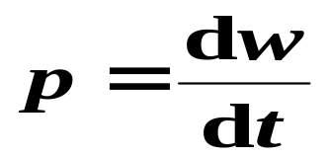
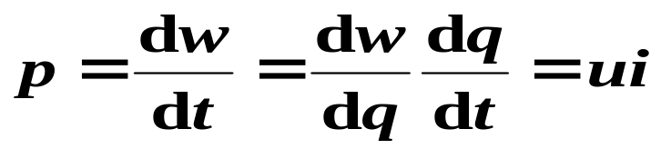
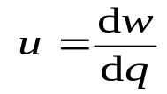
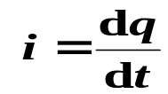
1.4 Power and Energy
Power is the time rate of expending or absorbing energy, measured in watts.
We write this relationship as
Where p is power in watts (W), w is energy in joules (J), and t is time in second (s).
The power p is a time-varying quantity and is called the instantaneous power.

Slide 23
By the passive sign convention, current enters through the positive polarity of the voltage. In this case, p = +vi or vi > 0 implies that the element is absorbing power.
However, if p = −vi or vi < 0, the element is releasing or supplying power.
i
i
+
+
v
v
–
–
P = +vi
absorbing power
P = –vi
supplying power

Slide 24
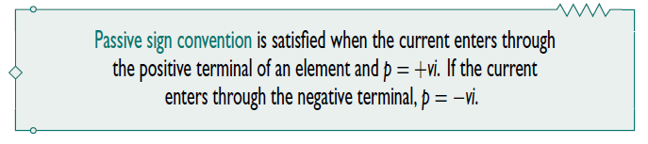
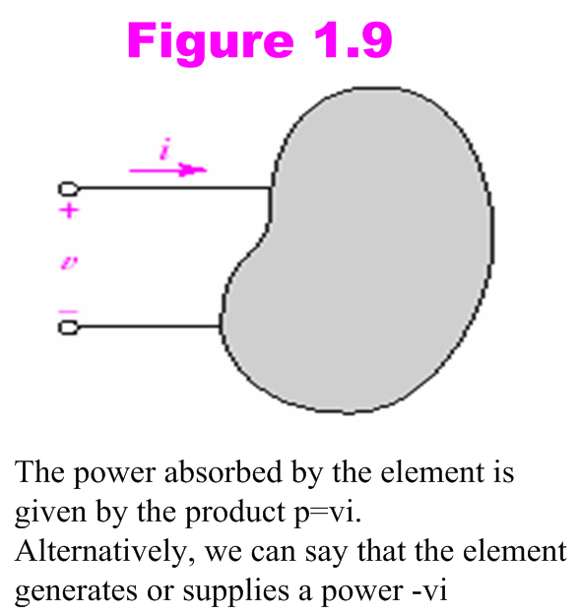
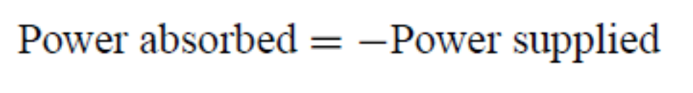

Slide 25
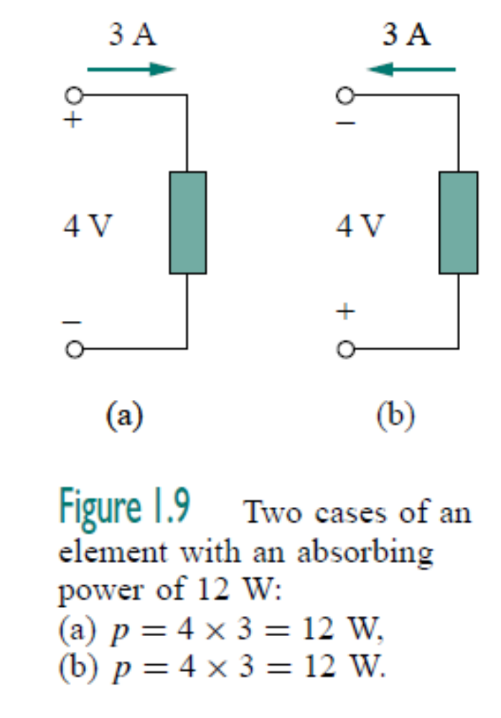
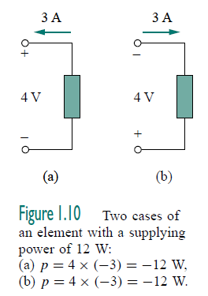

Slide 26
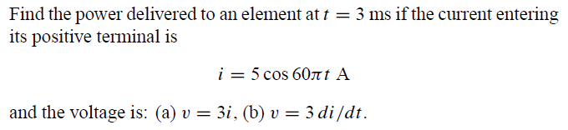
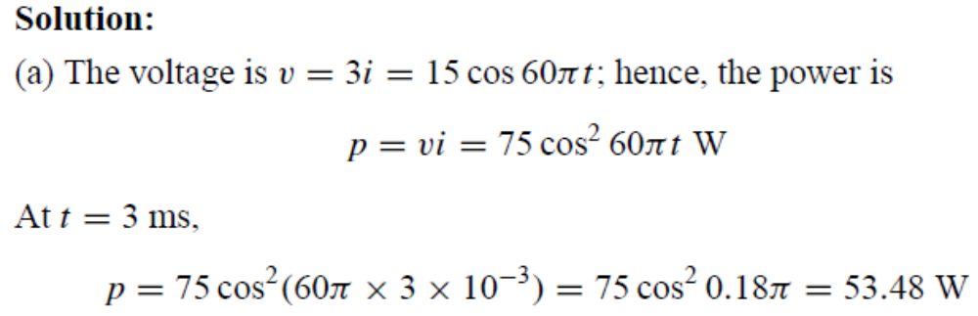
EXAMPLE 1.5

Slide 27

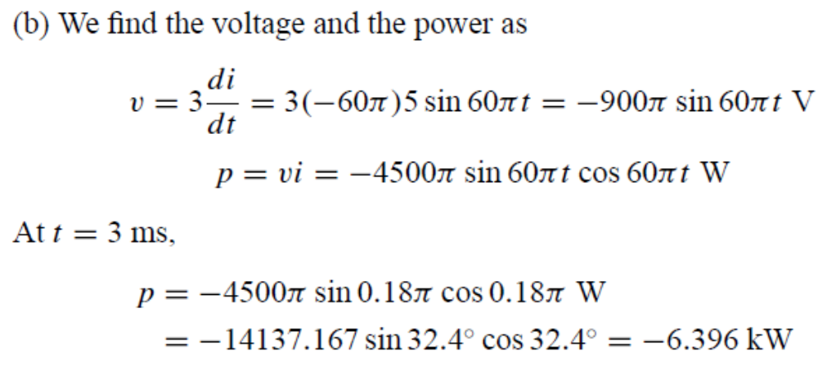
EXAMPLE 1.5

Slide 28
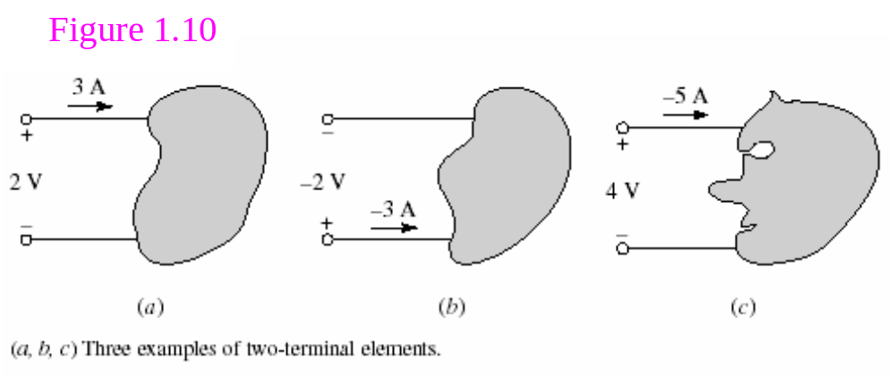
Example
Compute the power absorbed by each part in Fig. 1.10

Slide 29
Solution
In Figure 1.10a, with +3 A flowing into the positive reference terminal, we compute
P = (2 V) (3 A) = 6 W
of the power absorbed by the element.

Slide 30
Solution
Fig. 1.10b shows a slightly different picture. Now we have a current of -3 A flowing into the positive reference terminal. However, the voltage as defined is negative. This gives us an absorbed power
P = (-2 V) (-3 A) = 6 W

Slide 31
Reference to Fig. 1.10c, we again apply the passive sign convention rulers and compute an absorbed power
P = (4 V) (-5 A) = -20 W
Since we computed a negative absorbed power, this tells us that the element in Fig. 1.10c is actually supplying +20 W (i.e., it’s a source of energy).

Slide 32
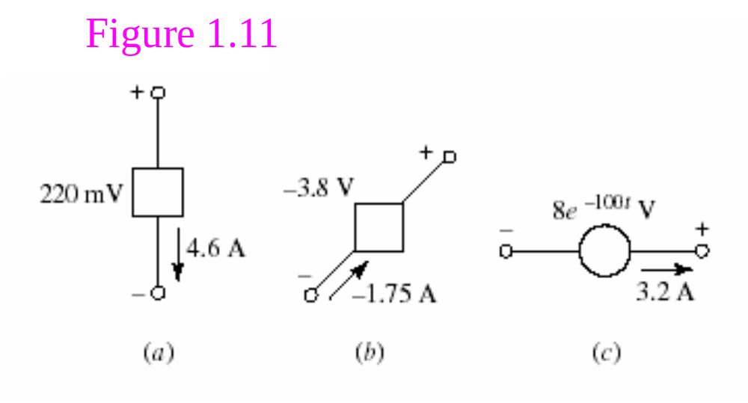
Practice 1.3
Find the power being absorbed by the circuit element in Fig. 1.11a.
Find the power being generated by the circuit element in Fig. 1.11b.
Find the power being delivered to the circuit element in Fig. 1.11c at t = 5 ms.
--------------------------------------------------------------
Answer : 1.012; 6.65w; -15.53

Slide 33
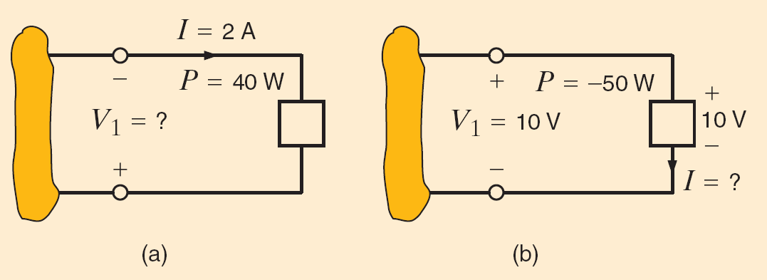
Practice : Determine the unknown variable in each circuit?
Circuit (a): V₁ = -20V
Circuit (b): I=-5A

Slide 34
Example:
+
U1
U6
－
+
Assume:
U1=1V, U2= -3V,
U3=8V, U4= -4V,
U5=7V, U6= -3V
I1=2A, I2=1A,
I3= -1A
1
6
I1
+
－
+
2
U2
U4
4
5
U5
－
－
+
U3
I2
I3
+
－
3
Solution:

Slide 35
1.5 Circuit Elements
A element is the basic building block of a circuit.
An electric circuit is simply an interconnection of the elements.
Circuit analysis is the process of determining voltages across (or the currents through) the elements of the circuit.
There are two types of elements found in electric circuits:
  Passive elements: An passive element is not capable of generating energy. Example passive element are resistors, capacitors, and inductors.
  Active elements: An active element is capable of generating energy. Type active element include generators, batteries, and operational amplifiers.

Slide 36
There are two types of elements found in electric circuits: passive elements and active elements.
An active element is capable of generating energy while a passive element is not.
Examples of passive elements are resistors, capacitors, and inductors.
Typical active elements include generators, batteries, and operational amplifiers.

Slide 37
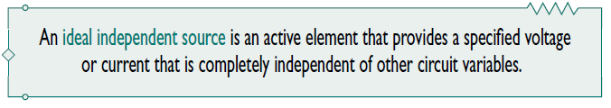
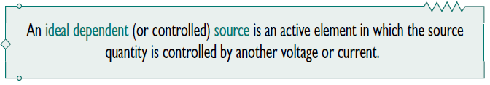
1. Sources
The most important active elements are voltage or current sources that generally deliver power to the circuit connected to them.
There are two kinds of sources: independent sources and dependent sources.

Slide 38
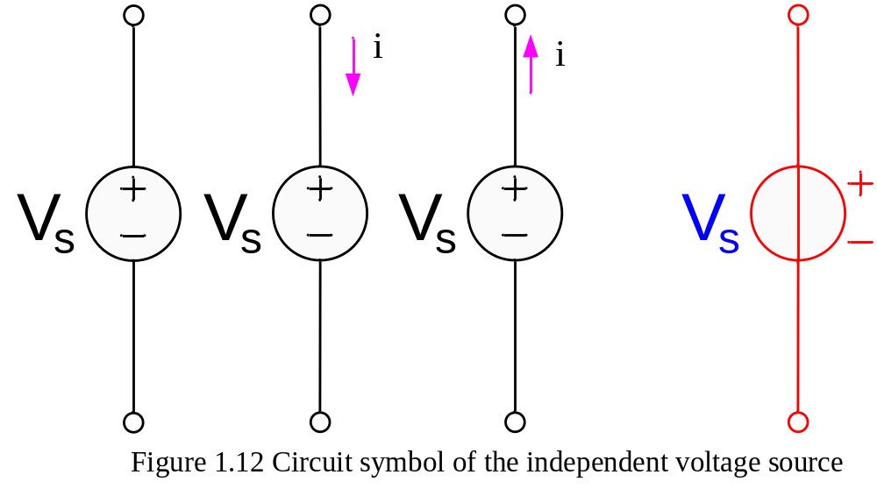
Independent Voltage Sources
The first element we will consider is the independent voltage source.
Circuit symbol
An independent voltage source is characterized by a terminal voltage which is completely independent of the current through it.

Slide 39
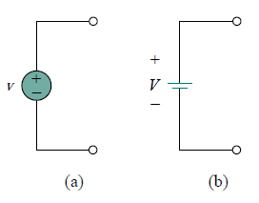
Both symbols in Fig. (a) and (b) can be used to represent a dc voltage source,
but only the symbol in Fig. (a) can be used for a time-varying voltage source.

Slide 40
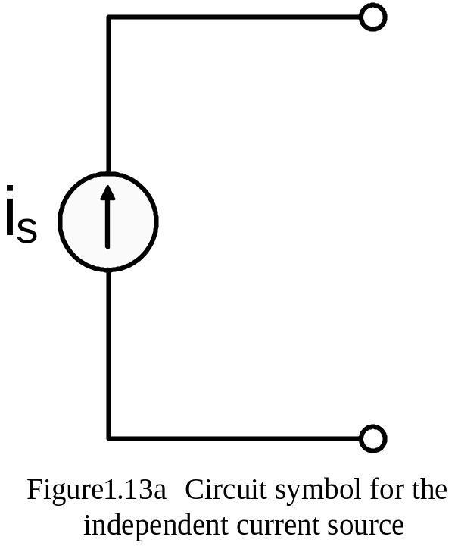
Independent Current Sources
Another ideal source which we will need is the independent current source.
Circuit symbol is shown in Fig.13
The current through the element is completely independent of the voltage across it.

Slide 41
Dependent (controlled) Sources
The source quantity of dependent sources is determined by a voltage or current existing at some other location in the system being analyzed.
There are four kind of Controlled Sources, that is,
  current-controlled current source, CCCS;
  voltage-controlled current source, VCCS;
  voltage-controlled voltage source, VCVS;
  current-controlled voltage source, CCVS .
  Circuit Symbols is shown in Fig.1.14(a)

Slide 42
diamond-shaped symbols
gv_{x}
Kv_{x}
ri_{x}
Ki_{x}
(a)
(b)
(c)
(d)
Figure 1.14(a) The four different types of dependent sources:
current-controlled current source;
voltage-controlled current source;
voltage-controlled voltage source;
current-controlled voltage source.

Slide 43
gv_{x}
Kv_{x}
ri_{x}
Ki_{x}
(a)
(b)
(c)
(d)
The key idea to keep in mind is that a voltage source comes with polarities (+ −) in its symbol,
while a current source comes with an arrow, irrespective of what it depends on.
Dependent sources are useful in modeling elements such as transistors,operational amplifiers and integrated circuits.

Slide 44
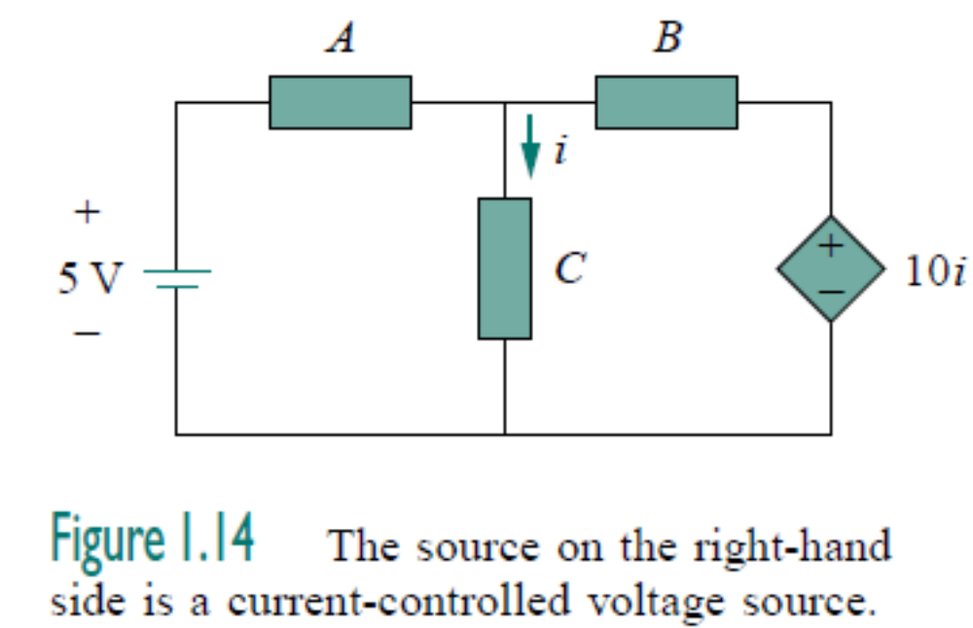
The voltage 10i of the voltage source depends on the current i through element C.

Slide 45
An element is the basic building block of a circuit
Passive elements
Resistors
Inductors
Capacitors
Active elements
Generators
Batteries
The most important active elements
Independent source
Voltage source
CCCS
CCVS
VCVS
VCCS
Current source
Dependent source

Slide 46
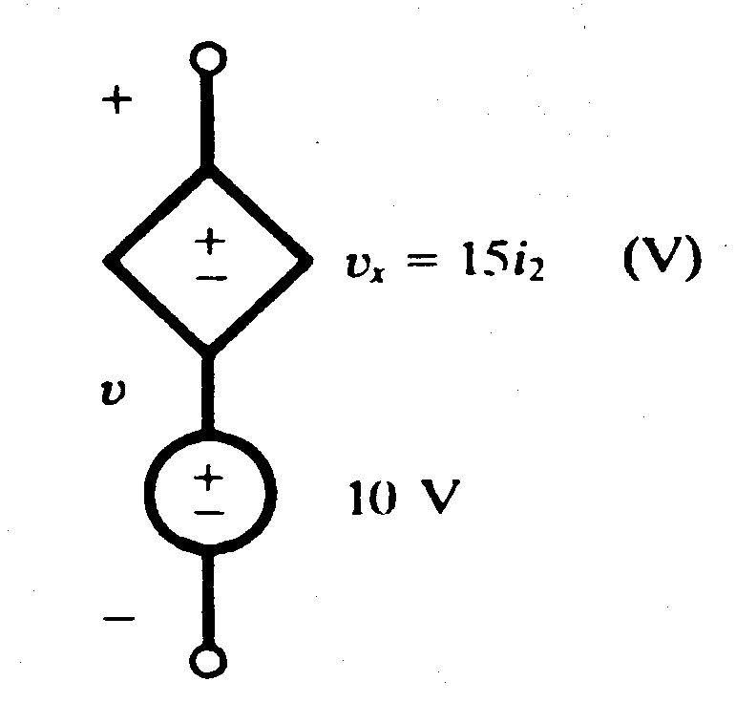
When dependent sources are given, their controlling current i_{x} and the controlling voltage v_{x} must be defined in the circuit.
Example 3
Obtain the voltage v in the branch shown in Figure 1.15 for i2 = 1A.
Figure 1.15

Slide 47
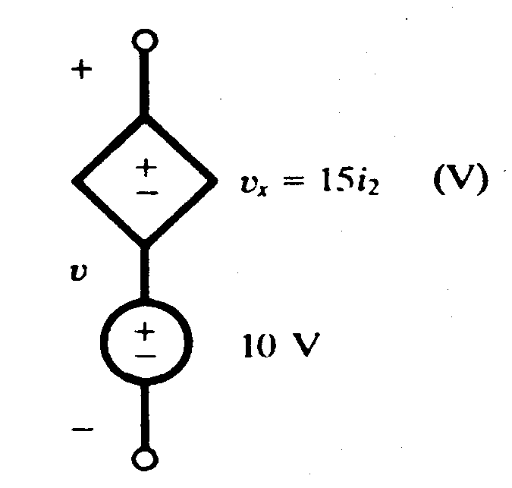
Solution
Voltage v is the sum of the current-independent 10-V source and the current-dependent voltage source v_{x}.
Note that the factor 15 multiplying the control current carries the units Ω.
Therefore, v = 10 + v_{x} = 10 + 15(1) = 25 V

Slide 48
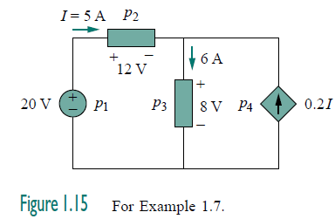
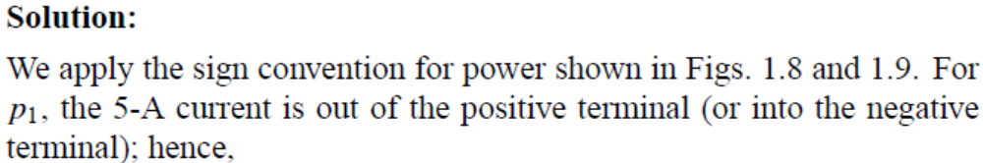
Example 1.17

Slide 51
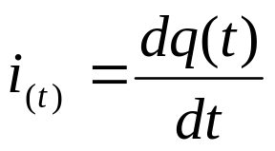
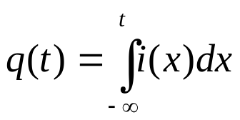
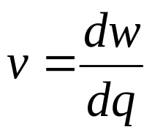
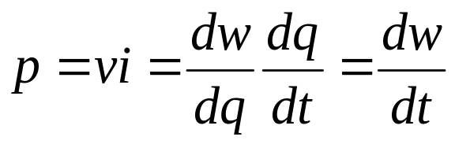
Summary
Current Amp
Charge Coulombs
Voltage Volts
Power Watts

Slide 52
An element is the basic building block of a circuit
Passive elements
Resistors
Inductors
Capacitors
Active elements
Generators
Batteries
The most important active elements
Independent source
Voltage source
CCCS
CCVS
VCVS
VCCS
Current source
Dependent source

Slide 53
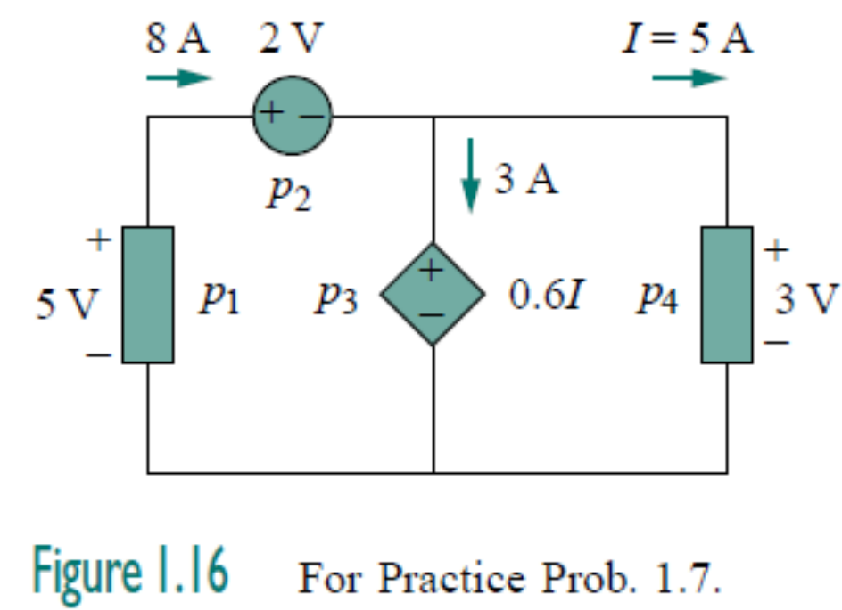
Practice
----------------------------------------------------------------------------------------------------------------------------------------------------------------------------------------------------------------------------------------------------
Find the power absorbed by each element in the circuit in Fig. 1.16.

Slide 54
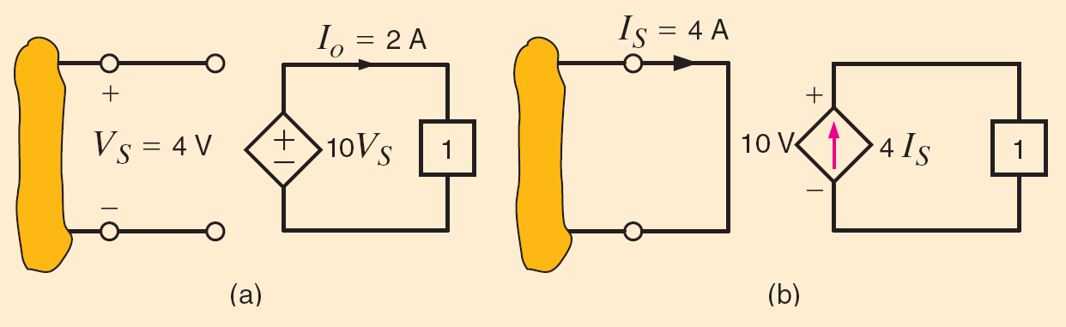
Determine the power supplied by the dependent sources
Practice

Slide 55
SUMMARY OF CHAPTER 1
1. An electric circuit consists of electrical elements connected together.
2. The International System of Units (SI) is the international measurement language, which enables engineers to communicate their results. From the six principal units, the units of other physical quantities can be derived.

Slide 56
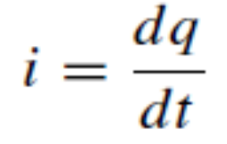
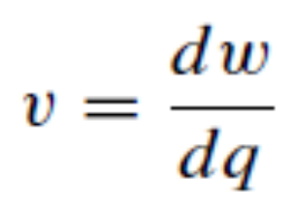
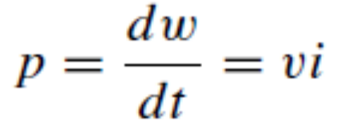
SUMMARY
3. Current is the rate of charge flow.
4. Voltage is the energy required to move
1 C of charge through an element.
5. Power is the energy supplied or absorbed per unit time. It is also the product of voltage and current.

Slide 57
SUMMARY
6. According to the passive sign convention, power assumes a positive sign when the current enters the positive polarity of the voltage across an element.

Slide 58
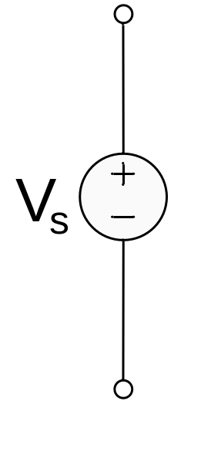

SUMMARY
7. An ideal voltage source produces a specific potential difference across its terminals regardless of what is connected to it.
8. An ideal current source produces a specific current through its terminals regardless of what is connected to it.

Slide 59
SUMMARY
9. Voltage and current sources can be dependent or independent. A dependent source is one whose value depends on some other circuit variable.
gv_{x}
Kv_{x}
ri_{x}
Ki_{x}
(a)
(b)
(c)
(d)

Slide 60
Practice
----------------------------------------------------------------------------------------------------------------------------------------------------------------------------------------------------------------------------------------------------
Find the power absorbed by each element in the circuit in Fig. 1.16.

Slide 61
Determine the power supplied by the dependent sources
Practice

Slide 62
Assignment (page 24)
Problems 1.2, 1.13, 1.15, 1.18, 1.20

Slide 63
1.5 Summary and Review
The system of units most commonly used in electrical engineering is the SI.
The direction in which positive charges are moving is the direction of positive current flow; alternatively, positive current flow is in the direction opposite that of moving electrons.
To define a current, both a value and direction must be given. Currents are typically denoted by the uppercase letter “I” for constant (dc) values, and either i (t) or simply i otherwise.

Slide 64
To define a voltage across an element, it is necessary to label the terminals with “+” and “-” signs as well as to provide a value (either an algebraic symbol or a numerical value).
Any element is said to supply positive power if positive current flows out of the positive voltage terminal. Any element absorbs positive power if positive current flows into the positive voltage terminal.
There are six sources: the independent voltage source, the independent current source, the CCCS, VCCS, and the CCVS,VCVS.

